Slide 1
CPBP 8306: Statistics & visualization day 1
Stevenson Science & Engineering Library
Joshua Borycz

Slide 2
Basic univariate statistics

Slide 3
Basic univariate statistics
Function | Data Type | Brief Explanation | Example Variables
t-test | Numeric | Compares the means of two groups to determine if they are statistically different. | Height, test scores
Two sample t-test | Numeric | Compares the means of two independent groups to determine if they are significantly different. | Income, education level
Paired t-test | Numeric | Compares the means of two related groups, such as before and after measurements on the same individuals. | Blood pressure before and after treatment
Chi-square | Categorical | Tests the independence of two categorical variables in a contingency table. | Gender and voting preference
Correlation | Numeric | Measures the strength and direction of the linear relationship between two numeric variables. | Age and income, height and weight
Linear model | Numeric | Fits a linear regression model to predict a numeric dependent variable from one or more numeric independent variables. | Sales and advertising budget, test scores and study time
ANOVA | Numeric | Analyzes the variance in a numeric dependent variable explained by one or more categorical independent variables. | Test scores and teaching method
Notes:
Note: We have only restructured the data and removed non data content (e.g., title and descriptions)
The data still contains the same number of cells, but now facilitates machine analysis
Good practice to only include data in your data file and all other contextual information should be addressed in other locations (e.g., ReadMe, data dictionary)

Slide 4
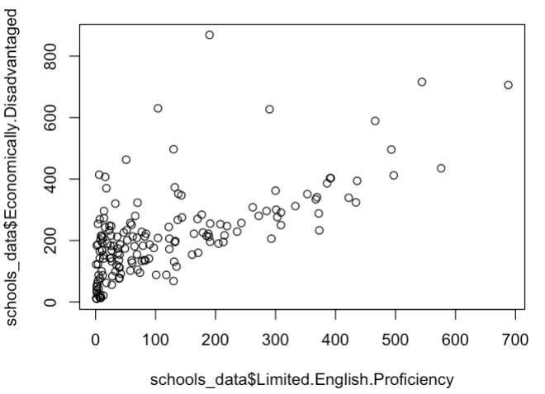
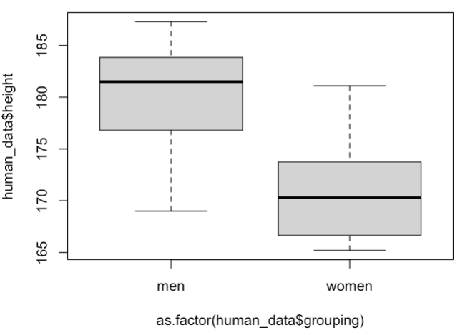
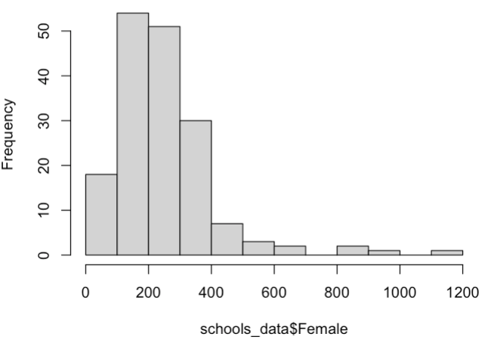
Basic plots
plot(): The workhorse function for creating a variety of plots, including scatter plots, line plots, and bar plots.
hist(): Creates a histogram.
boxplot(): Creates a box-and-whisker plot.
barplot(): Creates a bar plot.
Base R plots are not the prettiest and require some effort to improve
Grammar of graphics plots (ggplot2) allows for easy addition of data and aesthetic layers
Notes:
Note: We have only restructured the data and removed non data content (e.g., title and descriptions)
The data still contains the same number of cells, but now facilitates machine analysis
Good practice to only include data in your data file and all other contextual information should be addressed in other locations (e.g., ReadMe, data dictionary)

Slide 5
Grammar of Graphics Plots (ggplot2)

Slide 6
Grammar of graphics
ggplot2 breaks plots up into layers/components so that new data can be added simply
Core elements
Data: ggplot2(data)
Aesthetics: ggplot2(data,aes(x=year, y=number,color=name))
Geometries: ggplot2(data,aes(x=year,y=number,color=name)) +
geom_line()
Optional elements
Facets: + facet_wrap(~year, nrow=10)
Coordinates: + scale_x_continuous() + xlab() + ylab()
Theme: + theme(legend.position=“bottom”,axis.title=element_text(size=12))
Guides: + guides(color = guide_legend(nrow = 2))

Slide 7
Loading in data
Load in data and choose aesthetics
Universal
ggplot(data, mapping=aes(x=year, y=number, fill=name)) +
geom_col()
Individual geometry
ggplot() +
geom_col(data, mapping=aes(x=year, y=number, fill=name))
Piping
data %>% ggplot() +
geom_col(mapping=aes(x=year, y=number, fill=name))

Slide 8
Combining & exporting plots
To combine plots use the patchwork package along with the plot_annotation() function
ggsave function is available in the ggplot2 package and can export as multiple PNG files, single PDF, jpeg, etc.
# Libraries
pacman::p_load(ggplot2, patchwork)
# Create plot
p1 <- ggplot(mtcars) + geom_point(aes(mpg, disp))
p2 <- ggplot(mtcars) + geom_boxplot(aes(gear, disp, group = gear))
# Combine using patchwork
plot_combo <- p1 + p2 + plot_annotation(title = 'This is a title', caption = 'made with patchwork', tag_levels = 'A')
# Export
ggsave('plot_combo.png', plot = plot_combo, scale = 1, width = 5, height = 2.5, dpi = 300, limitsize = TRUE)

Slide 9
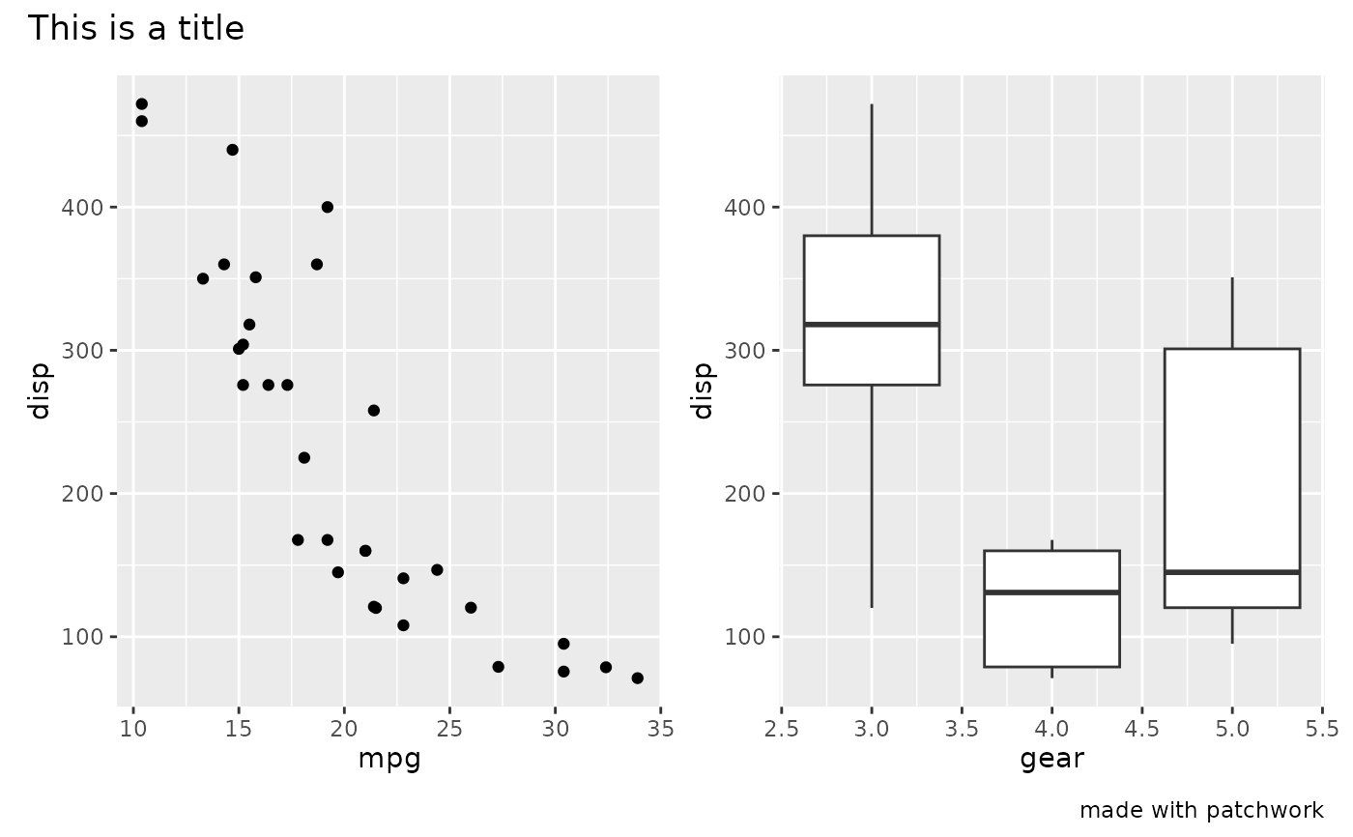
Combining & exporting plots

